Slide 1
How anti-obesity medications are impacting apparel retailing
Merchandising and marketing considerations and strategies
Kate McGee
Partner, Syndicated Retail Platforms
November 2023

Slide 2
Despite widespread pandemic weight gain and increases in making resolutions, we are seeing shoppers deprioritize physical health and wellness …
Types of New Year’s Resolutions
(among all shoppers)

Slide 3

… and a dramatic drop in those claiming to diet for weight-loss purposes
Types of Life Changes in January and Rest of Year
(among all shoppers)

Slide 4


At the same time, prescription weight-loss/ anti-obesity medication (AOMs) use has become prolific
9 million
AOMs were prescribed in Q4 2022
+300%
from early 2020
Analysts expect the AOM market to reach
$100 billion
by 2030, an increase from today of
~16X

Slide 5


We know AOMs are already impacting spending on consumables, but what about nonconsumables?
AOMs stand to greatly impact apparel retailing, so we’ll dig into how and where.

Slide 6
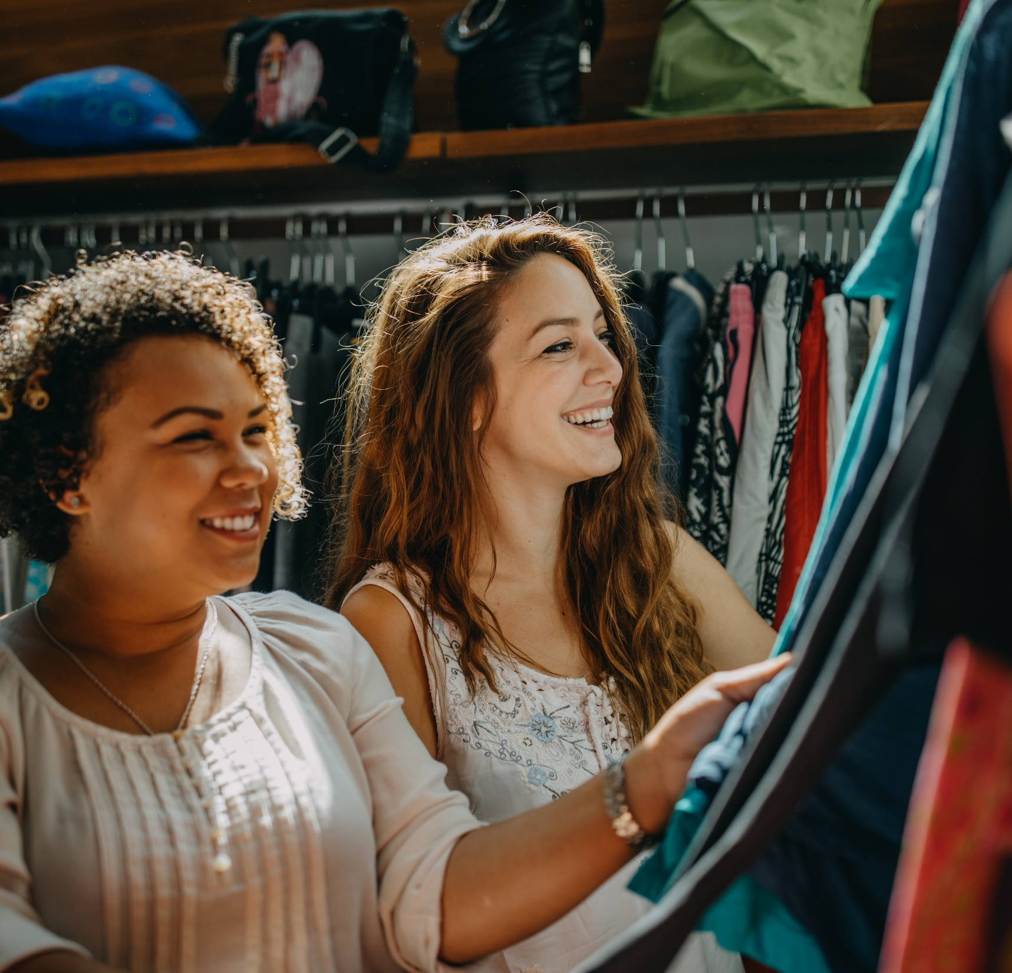
Agenda
1 | Merchandising considerations
2 | Marketing considerations
3 | Strategies to win
4 | Implications

Slide 7

1
Merchandising considerations

Slide 8

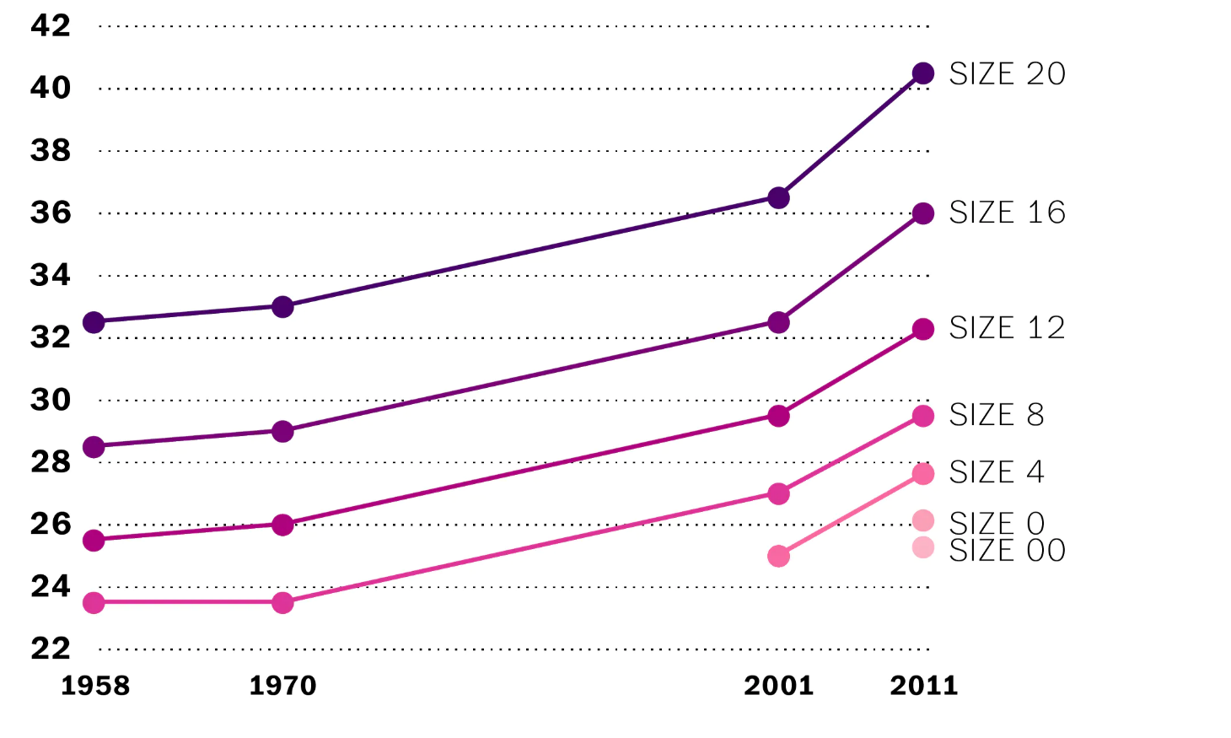
‘Vanity sizing’ has become increasingly popular with apparel merchants over time
Standard Measurements in Women’s Apparel in US
(waist, in inches)
Apparel has expanded into sizes smaller than 0.
A size 8 today is roughly the equivalent of a size 16 in 1958.
A similar trend in the UK caused its chief medical examiner to claim that vanity sizing is contributing to the “normalization of obesity.”

Slide 9

Buying decisions — often made six to nine months before product hits the market — are informed by sizing …
Sizing sell-through data is a key merchandising input
Speed to market is a competitive advantage in times of sell-through disruption
Lead Times for Apparel Sellers
(weeks to market)
Historical sizing sales inform:
Buying decisions
Allocation to retail stores
Inventory management
Hybrid
Vertical
0
10
20
30
40
50
Weeks to market
Consumers losing weight become shoppers buying smaller sizes: Future sizing curves may not look similar to historical ones.

Slide 10
… but buying missteps dramatically impact brands’ and retailers’ financial results
Impact on apparel is greater than it is for other categories because SKU sizing is personalized
to shoppers’ body size
Buying misstep
Shelf impact
Business impact
Out-of-stocks
Missed sales
Underbuying select sizes
Excessive markdowns
Decreased margins
Overbuying select sizes
Unsold merchandise
Undermines sustainability efforts
Estimated impact to a $1billion business is $20million in sales and $20million in margin.

Slide 11
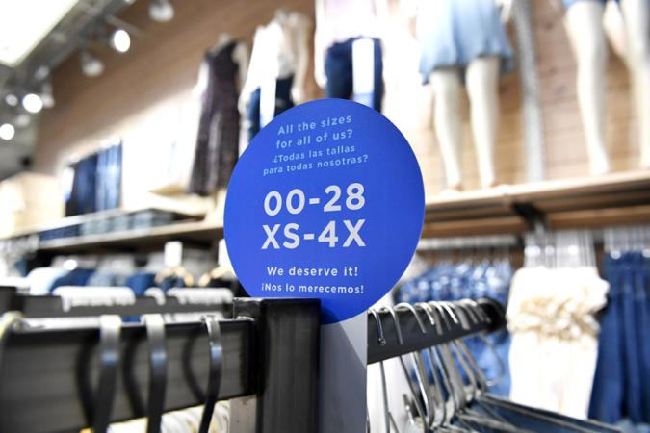

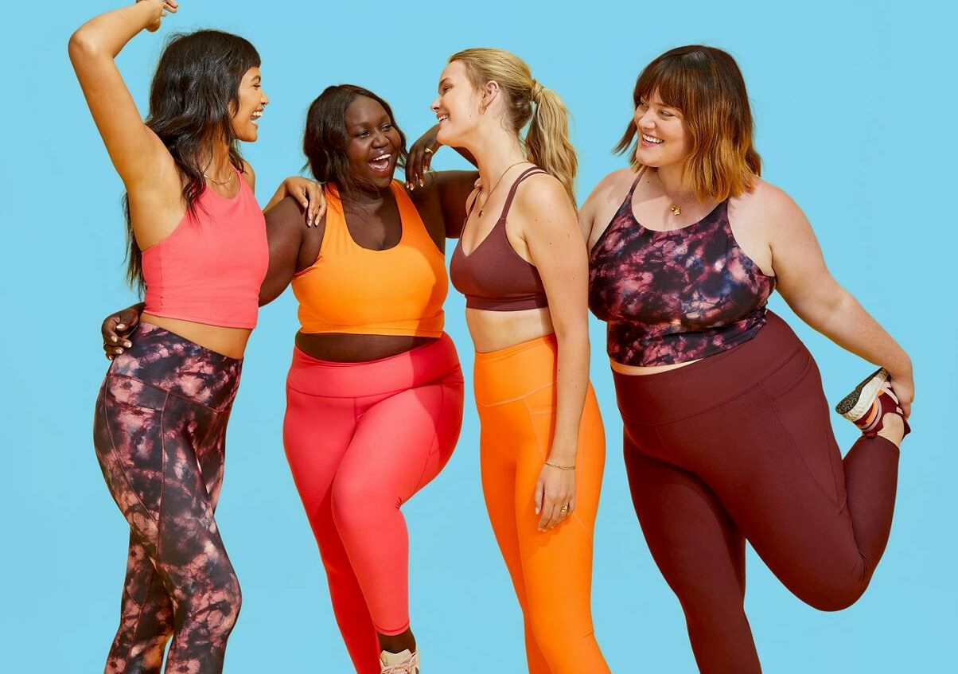
Case study:
Progressive sizing strategy backfires
The pivot in sizing strategy seemed sound.
In 2022, Old Navy doubled-down on body equality:
It invested in a wider range of apparel sizes from 0 to 28 and XS to 4X, with equal prices across all sizes.
It remerchandised the store layout, including putting all sizes of a style together, rather than having separate plus-size and petite departments.
Mannequins and in-store imagery showcased bodies across a wide range of sizes.
Data informed decisions, including:
Syndicated market research that indicated the weight of the average American woman had increased almost 5% since 2020
Qual and quant research: interviews and scanned bodies to create digital avatars and fit blocks.
The result wasn’t ideal.
Same-store sales dropped.
    New sizes didn’t bring in enough new shoppers.
    Expanded sizes took up too much real estate and lagged in sell-through.
Gap’s overall results suffered.
Old Navy CEO Nancy Green resigned.

Slide 12

Apparel players must prepare for AOMs to disrupt apparel sizing
Brands will have to lean into predictive merchandise buying.
Leverage AI size-match optimization.
Intentionally plan for a more dramatic size curve.
Consider supply chain adjustments to shorten lead times.

Slide 13
2
Marketing considerations

Slide 14
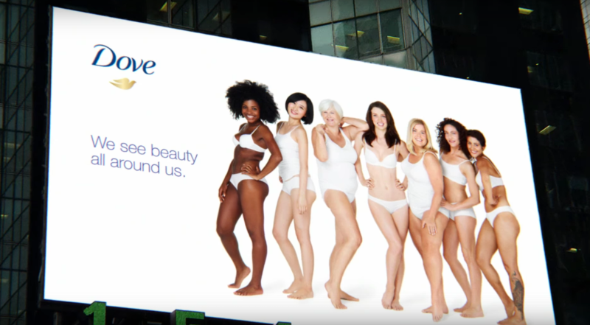
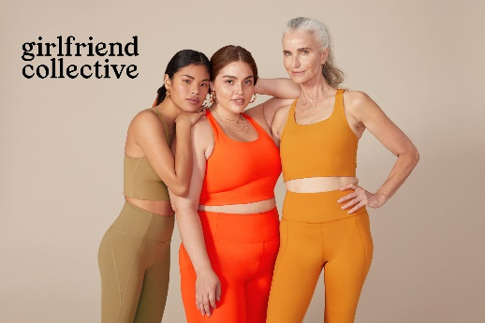
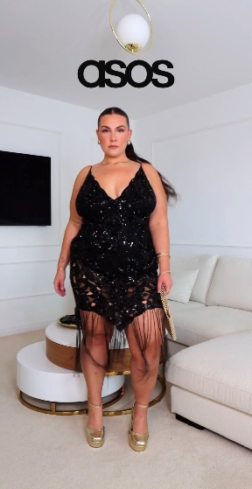
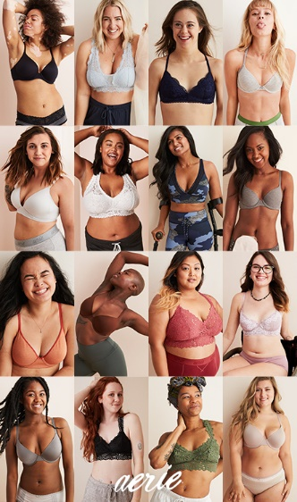
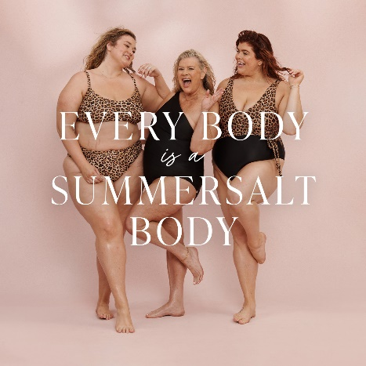
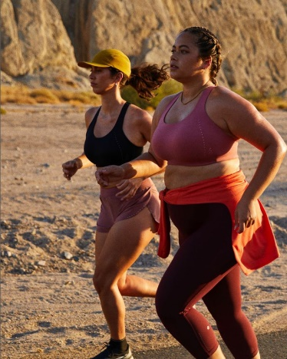
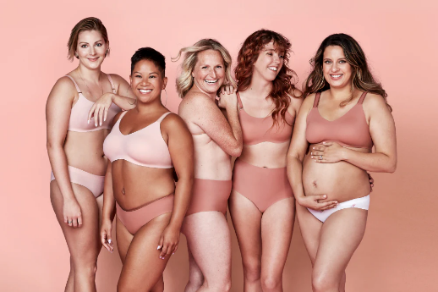


‘Body positivity’ has been a key initiative across many sectors, including apparel
Expanded sizing is reflected in marketing strategies
Dove: The original body-positivity brand
Direct-to-consumer brands
Mainstream brands
Note: “Body positivity” was added to the Oxford English Dictionary in March 2021.

Slide 15

However, the Gen Z demographic has mixed feelings about the importance of body positivity
Importance of Promoting Positive Body Image Diversity
(when buying a branded product, among U.S. Gen Z respondents)

Slide 16
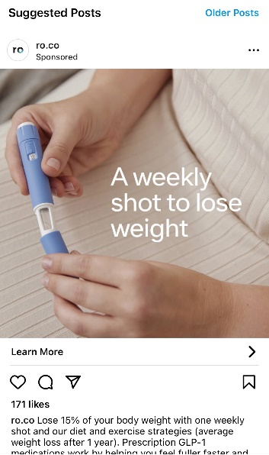


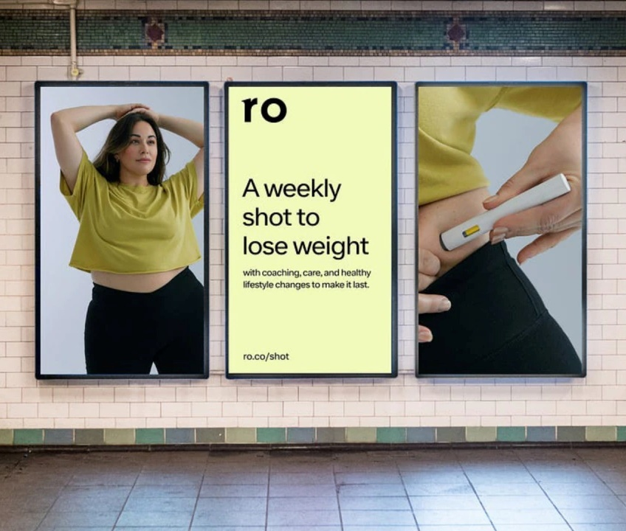
And now body-positive brands are competing for eyeballs with AOM manufacturers
AOM manufacturers spent
$500 million
on advertising in the first seven months of 2023
+20%
versus a year ago
The majority of this spend was on digital advertising platforms.
Note: Spend includes national TV broadcasts, print publications, newspapers and websites, and social media platforms.

Slide 17
Apparel brands and retailers will have to thread the needle to capture both body-positive and AOM shoppers
Going forward, brands will need to apply a surgical approach to appeal to body-positive and weight-loss drug audiences.
Reflect body positivity — on both the large and small sides of spectrum — in marketing imagery.
Invest in researching the shifting attitudes of
Gen Z shoppers about these divergent trends
to capture their critical share of wallet.

Slide 18
3
Strategies to win

Slide 19



We see three apparel retail strategies positioned to win from the weight-loss drug boom
Fast fashion
Supply chain
investments
Athleisure

Slide 20


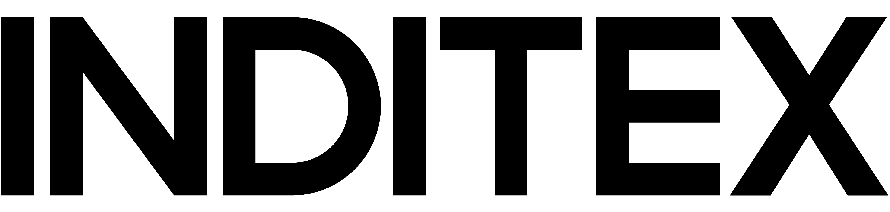
Fast-fashion players can lean into nimble supply chain
Anticipated wardrobe upgrades will benefit those who follow trends and can move quickly on size curve shifts
In general, shoppers refresh their wardrobes with every two size changes.
Women are more likely to refresh their wardrobes than men after losing weight.
The apparel industry is expected to gain $50 billion in incremental spend as a result of weight-loss drugs.

Slide 21









Investment in supply chain digitalization, AI, and near-shoring will drive wins for apparel retailers facing shifting shopper preferences from AOMs
Two-thirds of chief purchasing officers in the apparel sector anticipate that digitalization will be the most critical capability to drive growth.
Top Assignees of AI-Related Patents in Retail
(approximate number of publications, 2016-Q2 2023)
Moving production facilities closer to home markets dramatically tightens lead times and enables apparel players to react more quickly.

Slide 22

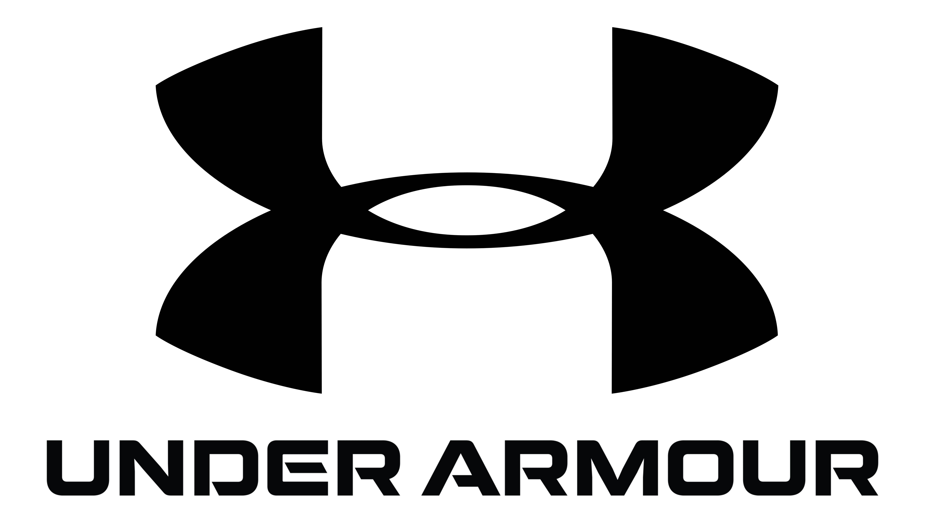
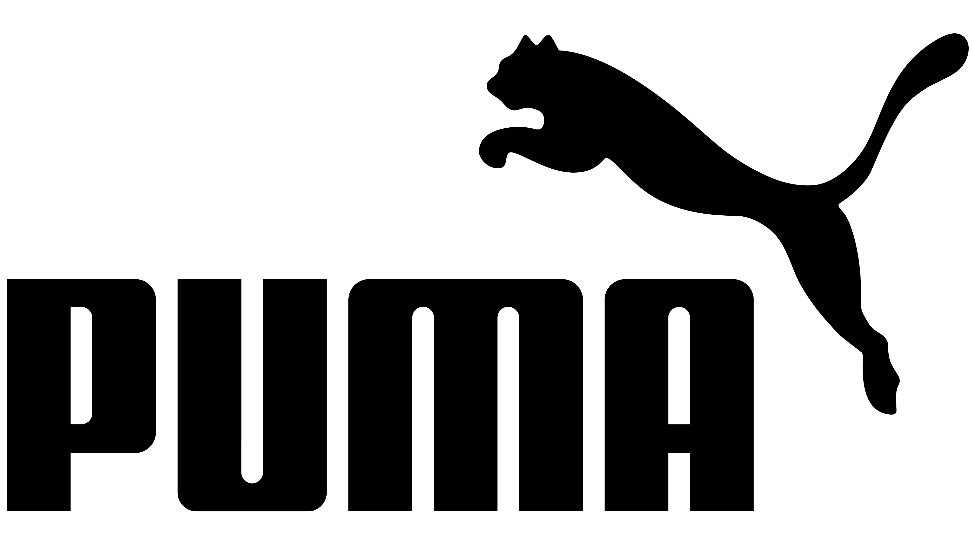


As AOM users double exercise, they increase their athleisure apparel purchases
Weekly Exercise Before/After Starting AOM
(total shoppers)
Change in Apparel Category Purchasing Since Starting AOM
(total shoppers)

Slide 23
4
Implications

Slide 24

What does the growth of AOMs mean for apparel players?
Product
Evolving shopper lifestyle choices mean a shift in product sell-throughs by sizes and category.
Supply chain
Nimbleness and reacting quickly will be more important as apparel players respond to evolving shopper needs.
Branding
Threading the needle with marketing and merchandising that appeal to a wide range of shopper body types will continue to be critical.
Though always an art and science
for apparel players, predictive and nimble design, planning, and buying will be critical to winning share of wallet in a post-AOM world.

Slide 25
Kate McGee
kate.mcgee@kantar.com
Kantar | 111 Huntington Ave., 20th Floor, Boston, MA 02199 | www.kantar.com

